Slide 1





3th year
Extraction and Access to Information in Natural Language for Non-Developers - Democratizing Information
Emanuel Matos
António Teixeira, Mário Rodrigues, Liliana Ferreira
Year of 1st registration: 2019 (Number of full-time equivalent years: 3)
PhD program: MAP-i

Slide 2
Research Challenge
Citizens, institutions, companies need
To keep updated and attentive to changes
To have simple and structured access to information
To have access to an increasing diversity of sources
Particularly relevant is information in Natural Language (texts, speech, videos, …)
A big challenge is to fulfil these needs with cost-effective solutions…
… and for required domains
Democratization of usage of such solution by non specialists

Slide 3
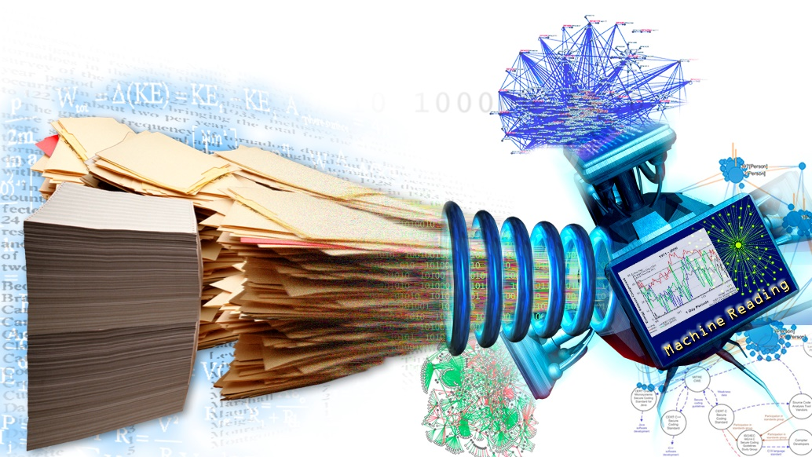
Research method and techniques
Engineering Research
Development of information extraction for non specialists
Application to Tourism domain
Main techniques
Recognition of Entities
(Open) Information Extraction
Automatic creation of datasets
Deep Learning (e.g. BERT/GPT_J)
Semantic knowledge bases
Tools for non specialists
to simplify the creation of information extraction

Slide 4
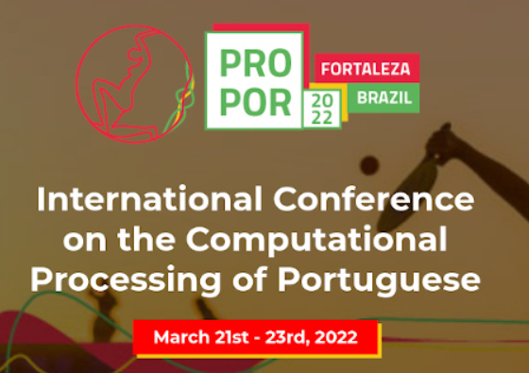
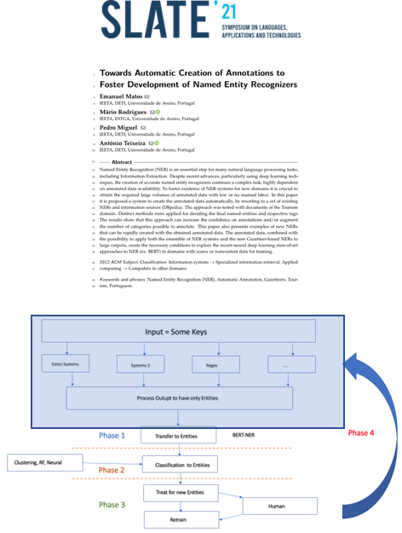
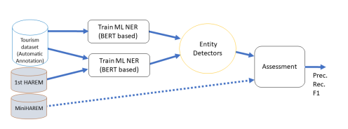
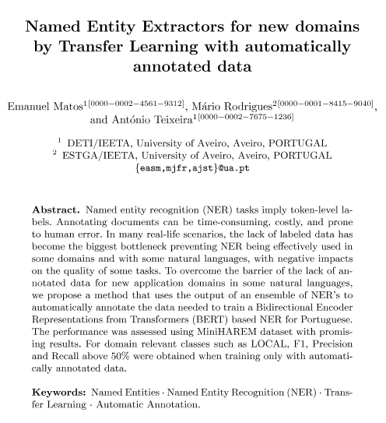
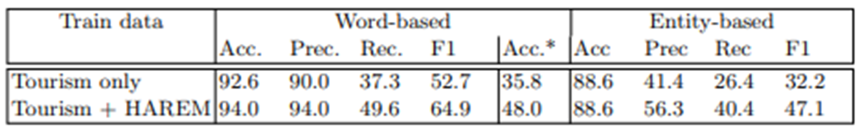
Did / To do

Slide 5
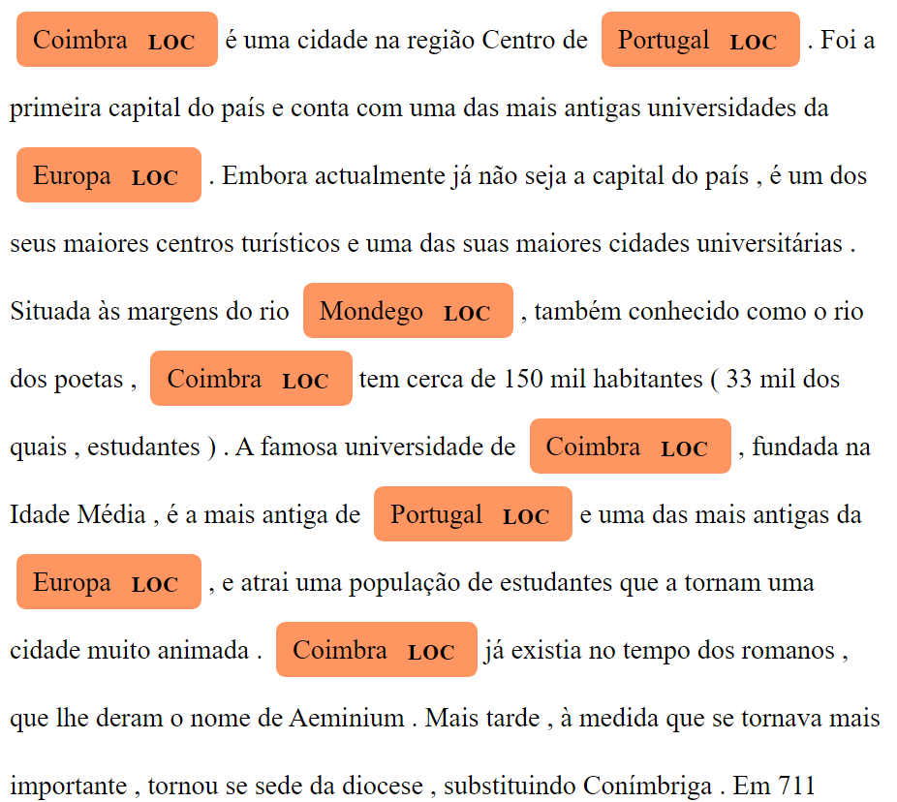
Next steps
Named Entity Recognition (AKA)
1
Improve the NERs integrating ex.: BERT-NER.
Increase dataset.
Improve the process of NERs output combination
Test the system in new domains.
Integrate the newly obtained NERs in an Information Extraction pipeline
2
Tools for non specialists
3
https://sustainabledevelopment.un.org/?menu=1300

